Slide 1
Use of Plastic Food Packaging Material
Name
Institution of Affiliation

Slide 2
Introduction
Increasing use of home deliveries and take away options for food.
Packaging material is disposable plates, cups, straw, and tumblers.
Made of plastic, which is not recycled but thrown into dumpsites.
Plastic take years to decompose thereby disrupting the natural process in landfills.
The amount of daily accumulation is alarming.
Notes:
Use of plastic has increased tremendously, especially with the current lifestyle where food is delivered to homes or processed as take-away options. Companies involved in this fast food business are owned by some of the most influential people in the United States. Therefore, despite the knowledge om the environment risks associated with use of plastic objects, they continue to be used and disposed to the environment. Plastic straws, tumblers, spoons, cups are some of the many plastic objects being dumped daily as waste. Most of this plastic objects are of one-time use and instead of being recycled, they find their way to the dumpsites. Plastics are no biodegradables and take millions of years to be degraded. The amount of daily accumulation is alarming.

Slide 3
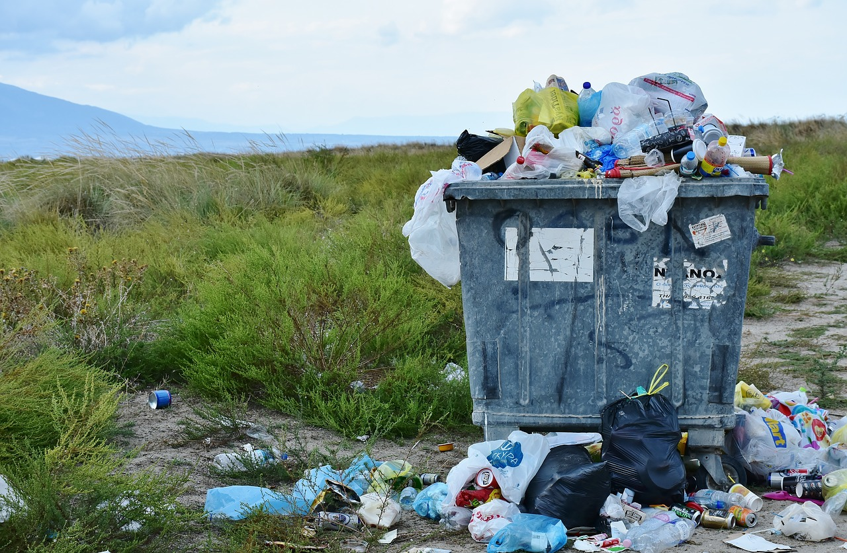
Notes:
The issue wit plastics is that they are major environmental pollutants. Their natural degradation process can take can take several years. As more of them get dumped in land fills, it hampers decomposition . Plastic debris is found absolutely everywhere, from the Arctic to Antarctica. It clogs street drains in our cities; it litters campgrounds and national parks, and is even piling up on Mount Everest. But thanks runoff, and to our fondness for directly dumping our trash into the nearest river or lake, plastic is growing increasingly common in the world’s oceans (Da Costa et al., 2016).

Slide 4
Product of Fracking
Resin pellets produced from fossil fuels to make plastics
Fossil fuel extraction results in fracking
Pollutes air, soil, and water with toxins.
Also creates subversive sinkholes that often collapse.
Pressure in underground rocks is raised with the instability causing earthquakes.
Notes:
Plastics are one of the main products of fracking. Basically, fossil fuels removed from shale and other rock formations are turned into resin pellets that are used to manufacture ever more plastics, plastics that are easily discarded, plastics that usually are designed to be single use. We already know that fracking is bad for the planet; it pollutes water, soil and air with toxins, it creates underground cavities that collapse into sinkholes, and it raises pressure in underground rock formations, destabilizing them and leading to earthquakes, even in places where earthquakes are uncommon (Filatov et al. 2018).

Slide 5
Fatal Effects of Plastic Use
Wildlife eat or become entangled in plastic debris.
More sea and land animals are dying lead to a public outcry.
Effects of malnutrition, and poisoning from chemical leaching from plastics.
Evidence that plastics have a role in extinction of species.
Over 700 marine species at risk of becoming extinct.
Resulting from the over 270,000 tons of plastic disposed in the sea.
Notes:
In the last few months, the effects upon wildlife that come from eating, or becoming entangled in, plastic debris have been reported more widely leading to public outcry and protests. These tragic events should come as no surprise: there are an estimated 270,000 tons of plastic floating through the world’s seas where it threatens 700 marine species with its presence. Further, there is growing evidence that plastics play a role in rising rates of species extinctions. Eating plastics results in malnutrition, intestinal blockage, or slow poisoning from chemicals leached from or attached to plastics (GrrlScientist, 2018).

Slide 6
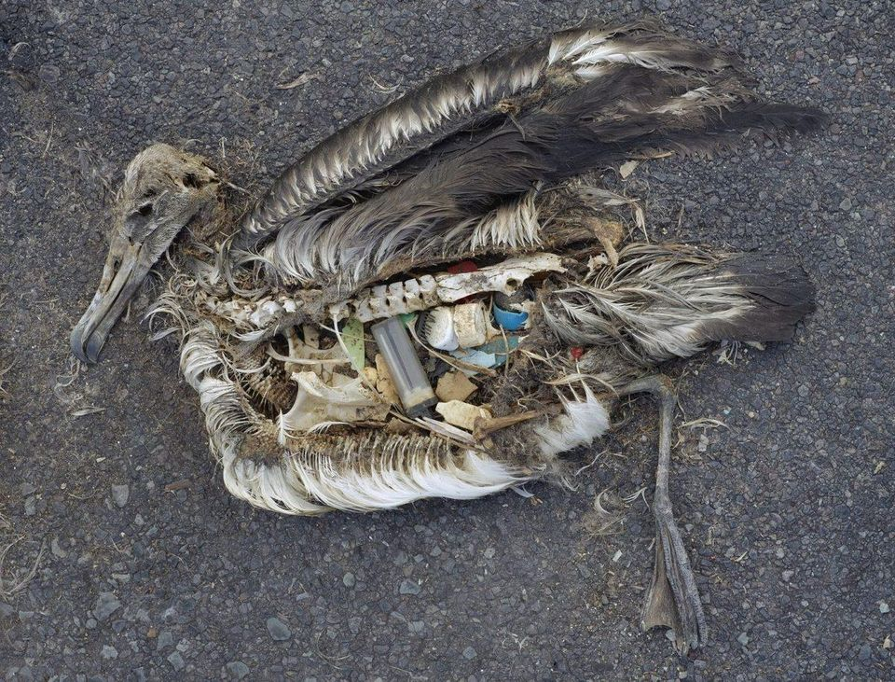
Chris Jordan / USFWS / Public domain
Notes:
It’s almost as if seabirds and other marine animals are intentionally seeking out plastics and consuming them. Recent research proposed that plastics in the oceans become covered with marine algae that release a natural sulfur compound, dimethylsulfoniopropionate (DMSP), when they die or become damaged. This chemical is detected by hungry seabirds and other marine creatures, which are attracted to it and then they mistake plastics for lunch (GrrlScientist, 2018).

Slide 7
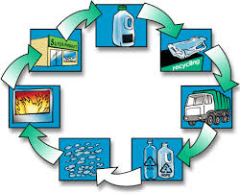
Plastics are beneficial too in the Environment
Notes:
Plastics could be used to benefit the environment. It is tempting to demonize plastics, but realistically, plastics themselves are not inherently evil. Plastics make life better, and easier, for us. For example, one of the first things you use every morning and one of the last things you use every night, your toothbrush, is made of plastics. Every time you visit your supermarket, you meet many sorts of plastics that serve as packaging to prolong the freshness of foods, and in a hospital, a variety of plastics help prolong your life (Law, 2017).

Slide 8
Reducing the Impact of Plastics
Plastic are made of long chain hydrocarbons.
Burning of plastics releases CO2 to the environment.
CO2 and Methane can be sequestered into plastics.
Prevent these gases from damaging the environment and climate.
Case of Mango Materials in California; harnessing microbes to convert methane to biopolymers that can generate degradable plastics.
Notes:
The key lies in the chemical structure of plastics. Plastics are made of polymers of carbon molecules, such as carbon dioxide (CO2) and methane (CH4). CO2 gas is produced by burning natural things, like gas, oil, wood or plastics. Basically, if we could permanently remove a portion of CO2 or CH4 gases from the atmosphere by sequestering them into plastics, we would effectively be preventing these gases from causing further damage to the climate. One such enterprising company, Mango Materials, a small firm in California, is working to reduce the methane gas problem in wastewater treatment plants by harnessing the ability of particular microbes to capture methane and stick them together to create polymers that then can be manufactured into larger and more useful pieces of plastic (GrrlScientist, 2018).

Slide 9
More Solutions
Companies have innovated ways to reduce plastic deposition into the environment.
Filabot converts plastic waste to filaments for use in 3D printers.
Avoids dumping of Plastics into oceans or being incinerated.
Caterpillars housing a group of microbes that can degrade plastics.
Development of a mutant enzyme that is effective in degrading plastics.
Notes:
Filabot is another company that is offering solution to plastic use. It converts plastic wastes into filaments that are utilized by 3D printers. This repurposes plastic waste into other useful forms instead of dumping it into the ocean, or incinerating it, which then liberates CO2 into the atmosphere where it can contribute to climate change.
Some caterpillars provide homes to a special collection of gut microbes that can biodegrade non-biodegradable plastics. This is a discovery that could lead to innovations in truly recycling plastics. A group of Japanese scientists developed a “mutant enzyme” that can degrade non-biodegradable plastic, PET, which comprises plastic water bottles (GrrlScientist, 2018).

Slide 10
Adopting Environmental friendly Material
People can opt to natural or plant based materials such as wooden spoons and forks, bamboo sticks for straw.
Use material that is environmental friendly i.e. undergoes quick natural decomposition.
Bamboo grows quickly; forks and spoons can be carved from small shrubs
Adoption of reusable packaging material.
Notes:
The use of natural/plant based materials- like using bamboo sticks for straws, wooden spoons and forks, cloth cover (or carrying your own cover everytime you buy some grocery or a take-away) and corn-starch based bowls, which are environment friendly and decompose quickly. Also, these do no result in deforestation as (i) bamboo is a grass that grows quickly, (ii) the wooden spoons and forks could made from barks of small shrubs that grow quickly and (iii) corn-starch is a waste product.

Slide 11
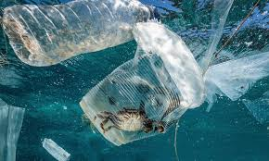
Notes:
Photograph shows a crab entangled in a plastic bottle in the sea. This is an example of plastic threatening life. Perhaps, realizing the e harm we are doing to the environment by disposing plastics would help reduce the pollution and think of better ways to dispose the non-biodegradable material or choose alternative safe ways.

Slide 12
Conclusion
Hope in innovations and new discoveries.
In microbes lies the potential to turn plastic immortality into a thing of the past.
Burning them would barely be a solution; it would expose CO2 and CH4 to the atmosphere.
For continued mutual existence among animal life on earth, such products have to be restructured.
Notes:
Hopefully these new innovations and discoveries will inspire yet more creative thinkers to harness the power of their imaginations, perhaps assisted by vast armies of microbes, so we can re-purpose apparently immortal plastics into other useful forms.

Slide 13
References
da Costa, J. P., Santos, P. S., Duarte, A. C., & Rocha-Santos, T. (2016). (Nano) plastics in the environment–sources, fates and effects. Science of the Total Environment, 566, 15-26.
Filatov, V. V., Zaitseva, N. A., Larionova, A. A., Zhenzhebir, V. N., Polozhentseva, I. V., Takhumova, O. V., & Kolosova, G. M. (2018). State Management of Plastic Production Based on the Implementation of UN Decisions on Environmental Protection. Ekoloji Dergisi, (106).
GrrlScientist. (2018). Five Ways That Plastics Harm The Environment (And One Way They May Help). Forbes. Retrieved from https://www.forbes.com/sites/grrlscientist/2018/04/23/five-ways-that-plastics-harm-the-environment-and-one-way-they-may-help/#66d246b267a0
Law, K. L. (2017). Plastics in the marine environment. Annual review of marine science, 9, 205-229.
Siracusa, V., Rocculi, P., Romani, S., & Dalla Rosa, M. (2008). Biodegradable polymers for food packaging: a review. Trends in Food Science & Technology, 19(12), 634-643.

